Slide 1

Personal Budget Tracker
Capstone Project Summary
Shady Hijazi & Noor Khateeb
Supervisor: Dr. Zeev Frenkel
Date: 4/2/2025

Slide 2
Introduction
Problem: Many struggle with tracking expenses & budgeting
Consequences: Debt, overspending, lack of savings
Solution: Personal Budget Tracker – Smart financial management tool

Slide 3

Personal Budget Tracker Main Goals
Develop
Develop a Comprehensive Personal Budget Tracker
Enable
Enable Real-Time Expense Tracking
Support
Support Customizable Budgeting & Savings Goals
Enhance
Enhance Financial Data Visualization
Ensure
Ensure Security & Privacy
Bridge
Bridge the Gap Left by Existing Solutions

Slide 4
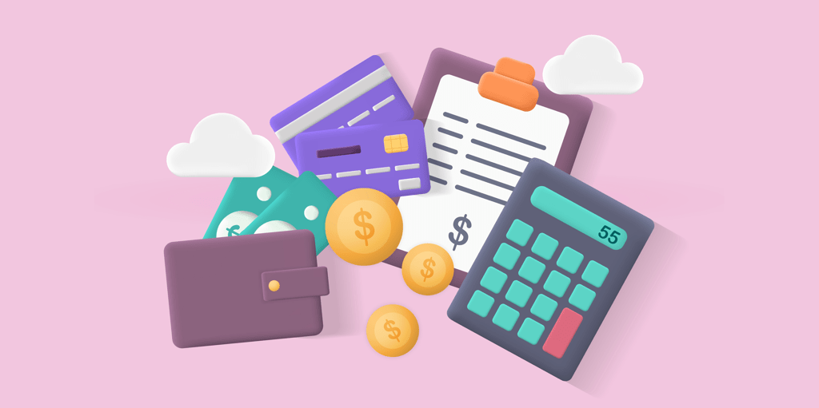
Background & Related Work
Existing Budgeting Tools & Their Limitations:
• Mint, YNAB, Goodbudget, PocketGuard – Lack of customization, misclassified transactions
• Banking Apps – Limited accounts
• Spreadsheets – Require manual tracking

Slide 5
Why Personal Budget Tracker (PBT)?
Addresses common issues:
✅ Free & user-friendly
✅ Customizable budgets
✅ Automated spending categorization
✅ Data visualization (charts & graphs)
✅ Secure data management

Slide 6
Features & Functionalities
Real-Time Expense Tracking 🛒
Customizable Budgeting Tools 💰
Savings Goal Tracking 🎯
Data Visualization & Reports 📊
Secure Data Management 🔒

Slide 7
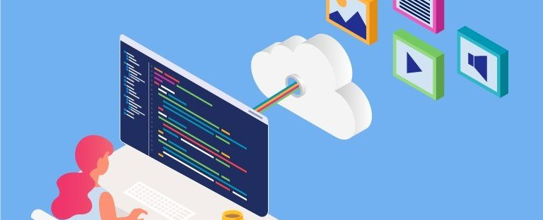
Technical Components
• Frontend: React.js
• Backend: Node.js & Firebase
• Database: PostgreSQL
• Security: End-to-end encryption & Two-Factor Authentication

Slide 8

Algorithms & Intelligence :
• K-Means Clustering – Analyzing spending patterns
• Linear Regression – Predicting future expenses
• Apriori Algorithm –
Finding spending habits
• Neural Networks – Personalized financial advice

Slide 9
Development Process
• Research 🔍
• Product Goal Definition 🎯
• Incremental Development Approach 🛠
• Security & Compliance (GDPR, CCPA) 🔐
• Challenges & Constraints (Technical, User, Market)

Slide 10
How are we going to test our product?
Testing Type | Execution | Expected Results
Code Quality & Maintainability | Static code analysis to detect bugs, redundant code, and inconsistencies. | Improved code performance, reduced maintenance errors, enhanced readability.
Functional & UI Testing | Unit tests, integration tests, and end-to-end user flow testing. | Ensuring all components work smoothly without significant UX bugs.
Performance Testing | Analyzing load speed and responsiveness under high usage conditions. | Faster response times, resource optimization, and a smoother user experience.
Security Testing | Penetration testing, identifying vulnerabilities, and GDPR/CCPA compliance checks. | Reduced security risks and enhanced user data protection.

Slide 11
How are we going to test our product?
Testing Type | Execution | Expected Results
Usability & UX Testing | Analyzing user experience, collecting feedback, and interface testing. | Improved navigation and enhanced user satisfaction.
Load & Scalability Testing | Simulating simultaneous usage by thousands of users. | Ensuring system stability and resilience under high loads.
Post-Deployment Testing | Real-time error tracking and server performance analysis. | Rapid response to app issues and ongoing performance improvements.

Slide 12
Expected Challenges
Challenge | Description
Ensuring Data Security | Complying with privacy standards while integrating strong security without compromising performance.
Testing Across Different Devices | Ensuring full compatibility with various devices and screen sizes.
Balancing Performance and Design | Enhancing UI/UX while maintaining speed and efficiency.
Handling High Traffic Loads | Supporting intensive usage, especially during monthly financial reports.
Collecting User Feedback & Improvements | Analyzing user responses and continuously improving the app.

Slide 13
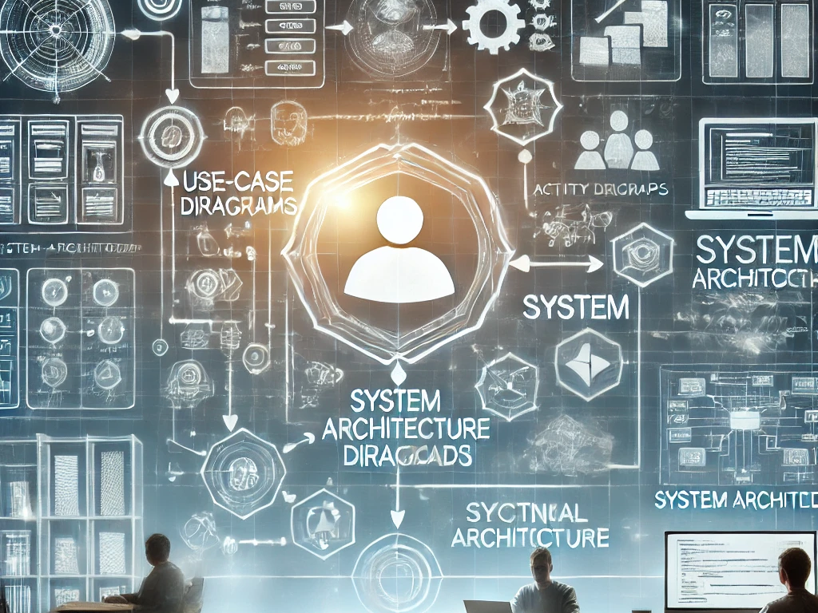
System Design & Architecture
• Use-Case Diagram
User interactions
• Activity Diagram
Workflow
• System Architecture
defines the structure

Slide 14
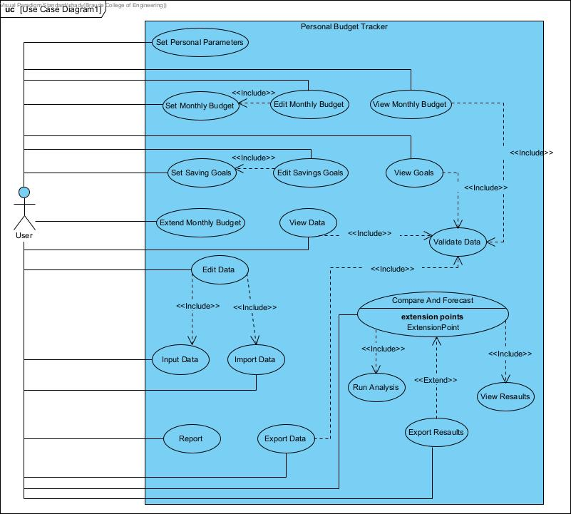
Use-Case Diagram

Slide 15
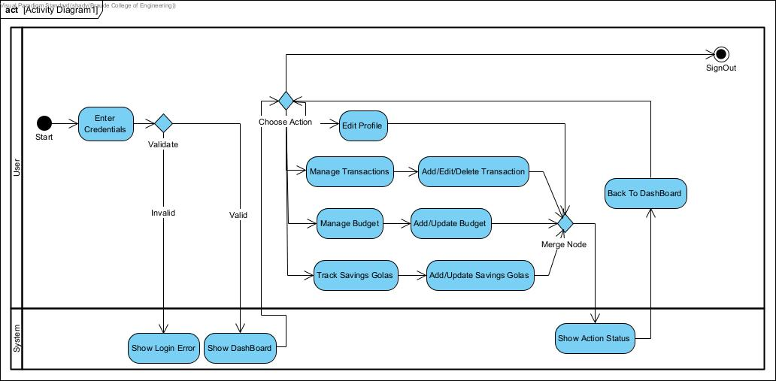
• Activity Diagram

Slide 16
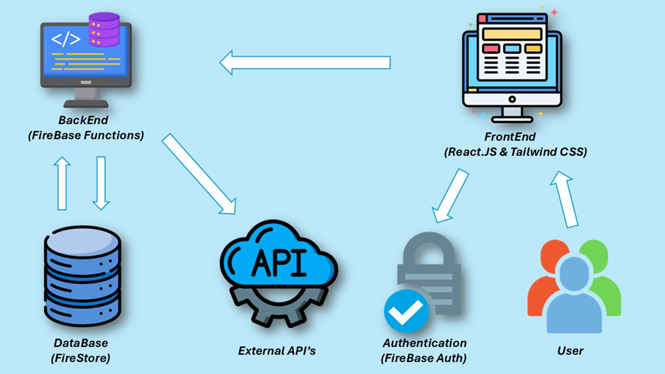
System Architecture

Slide 17
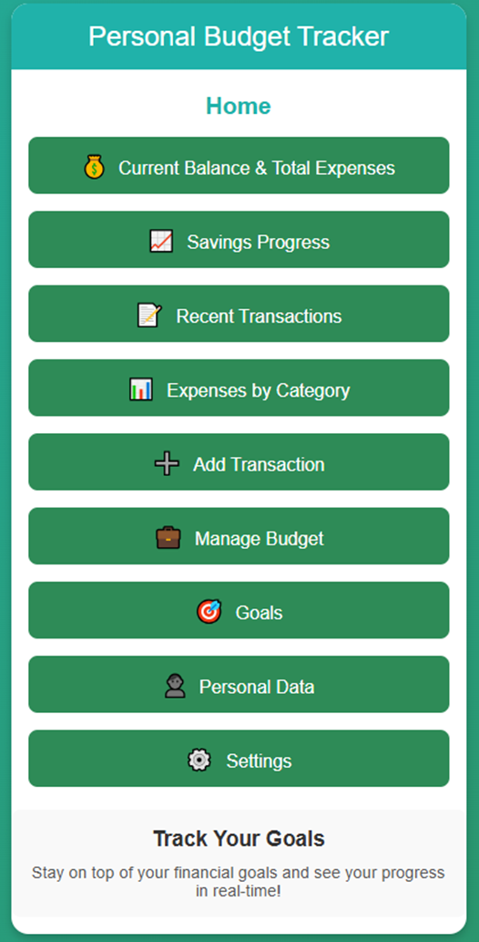
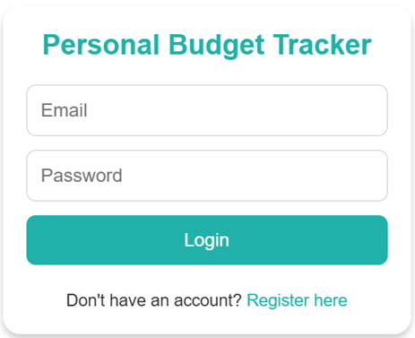
• Graphical User Interface
Login / Register Interface:
Home page interface:

Slide 18
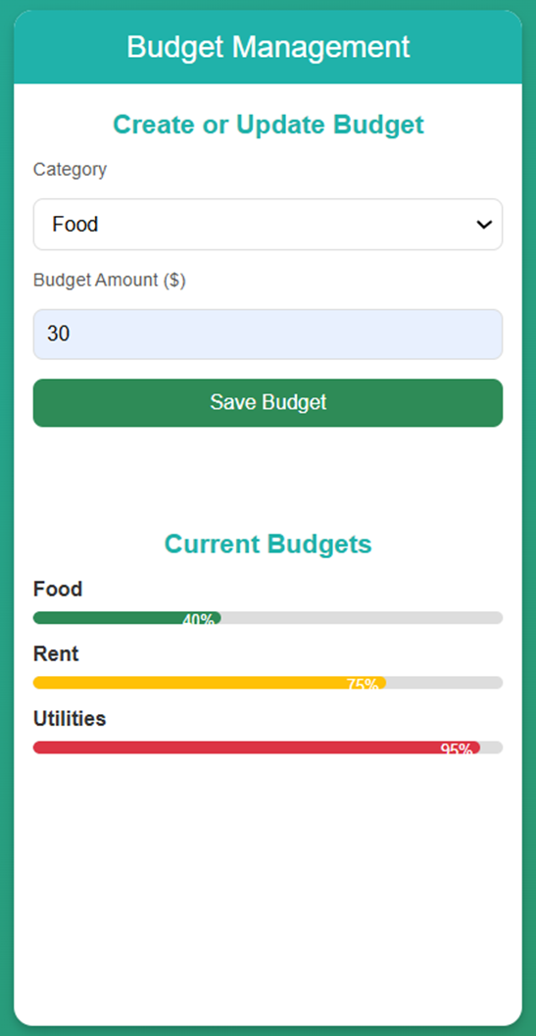
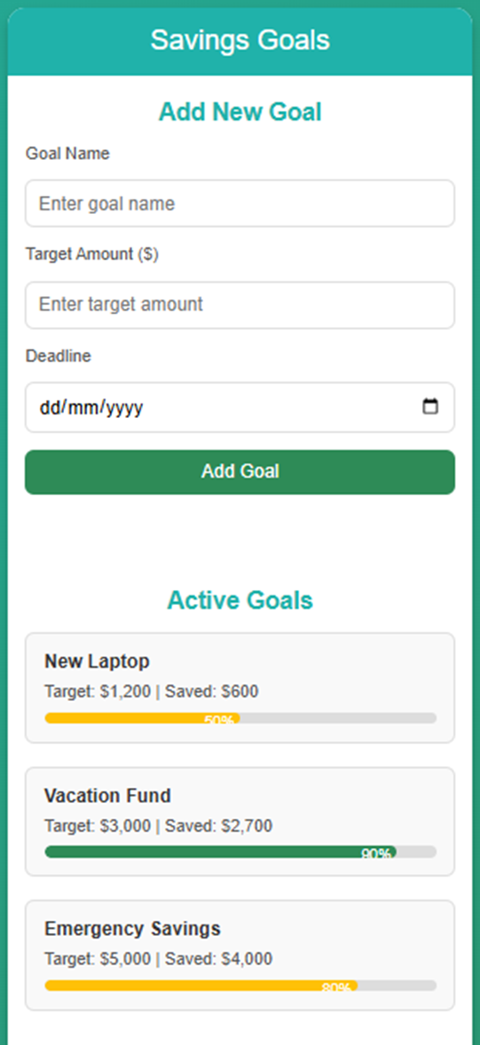
• Graphical User Interface
Budget Management Interface:
Savings Goals Interface

Slide 19
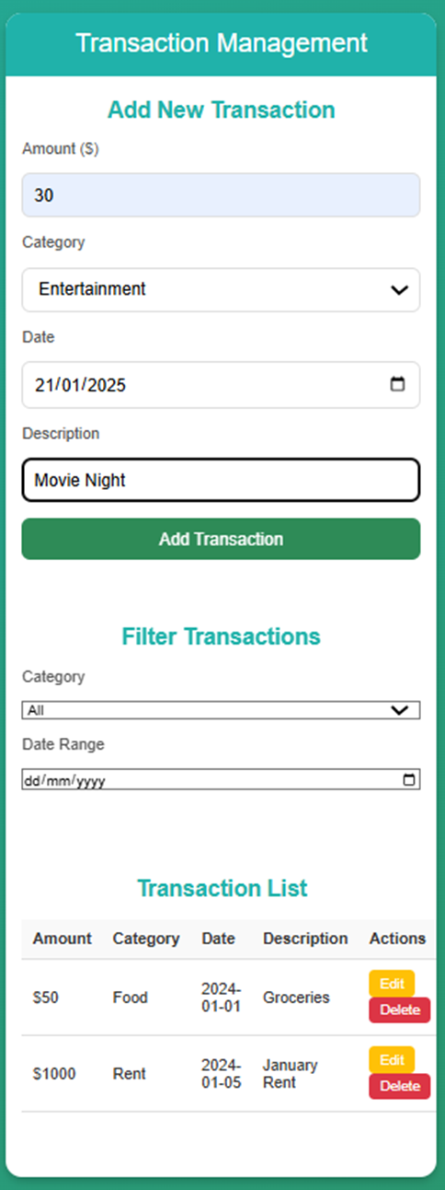
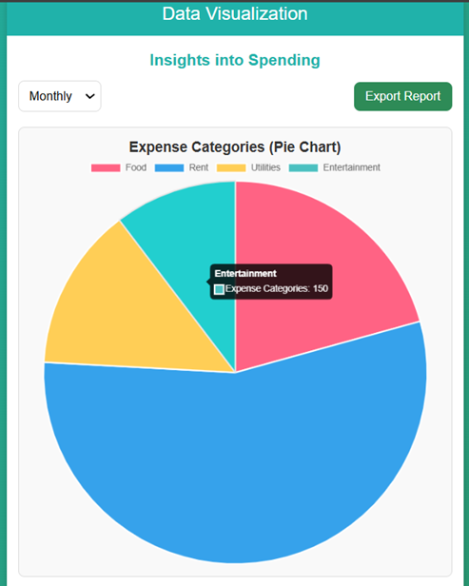
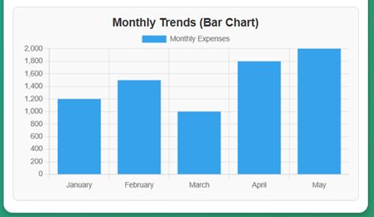
• Graphical User Interface
Transaction Management Interface:
Data Visualization Interface:

Slide 20
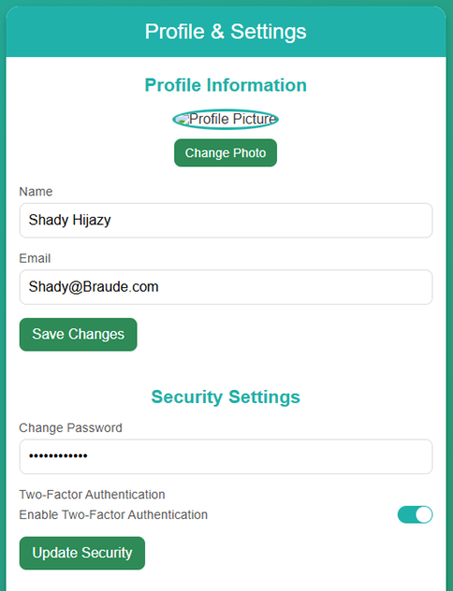
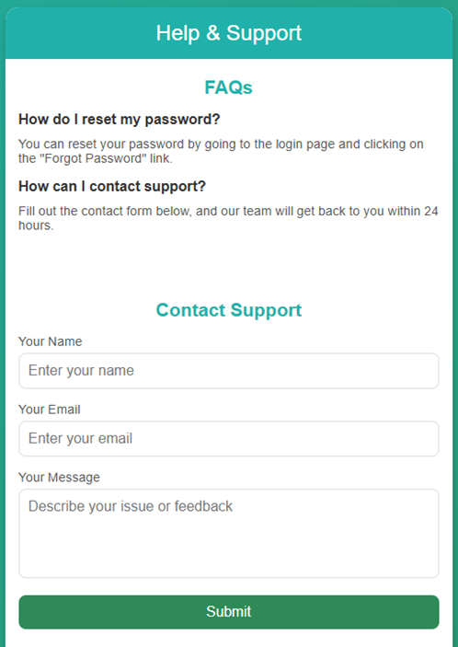
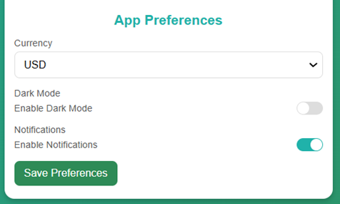
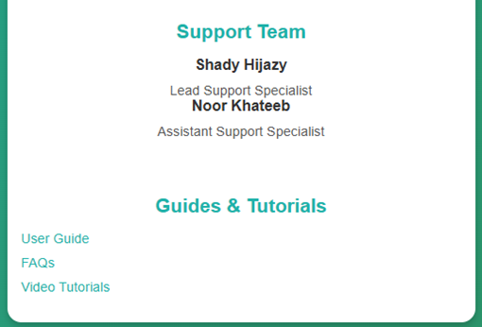
• Graphical User Interface
Profile Settings Interface:
Help & Support Interface:

Slide 21

Expected Achievements & Success Criteria
• User Adoption: 80% satisfaction
• Performance: Transactions update in <1 sec
• Financial Literacy Impact: 70% improve savings
• Security: Zero reported data breaches

Slide 22
Conclusion & Future Work
• Current Status: Features implemented, testing in progress
• Future Enhancements:
- AI-driven financial coaching
- More bank integrations
- Multi-currency support
• Empowering users with financial control!

Slide 23

Q&A
Thank You! 🙌
Any Questions? 🎤

